Slide 1
Working With Forms In React
A.KOWSHIK REDDY
22H61A0570
CSE-D

Slide 2
Introduction to Forms in React
Forms are a crucial part of any web application, allowing users to input data.
React provides a flexible way to handle form inputs and manage state.
Understanding how to work with forms in React is essential for creating interactive applications.
Notes:
Image source: https://medium.com/weekly-webtips/a-complete-guide-to-react-forms-15fa079c6177

Slide 3
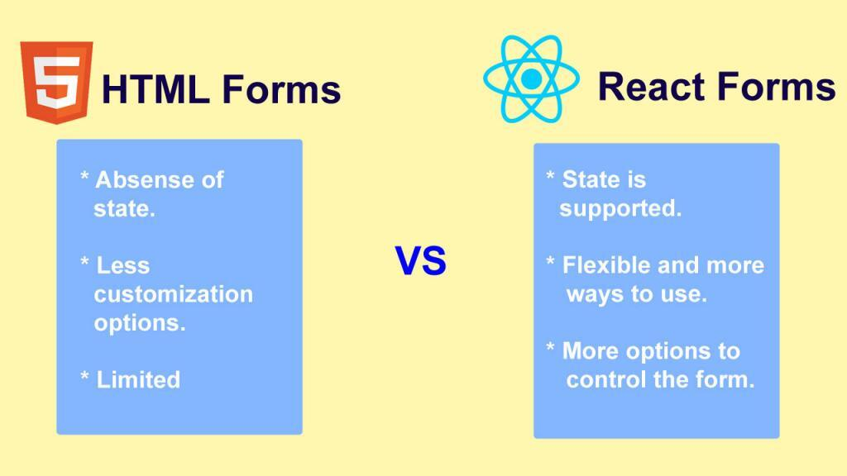
Types of Forms
There are two main types of forms in React: controlled and uncontrolled forms.
Controlled forms are those where form data is handled by the component state.
Uncontrolled forms allow the DOM to manage form data, using refs to access values.
Notes:
Image source: https://www.vrogue.co/post/react-forms-explained-easy-2020-reactjs

Slide 4
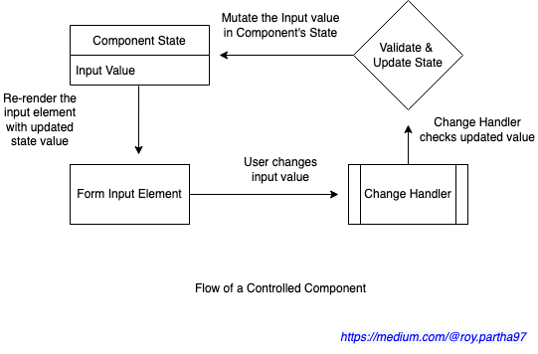
Controlled Components
In controlled components, the form data is controlled by React state.
Each input element’s value is set via state, and changes are handled with an event.
This approach provides a clear flow of data and easier validation.
Notes:
Image source: https://stackoverflow.com/questions/42522515/what-are-react-controlled-components-and-uncontrolled-components

Slide 5
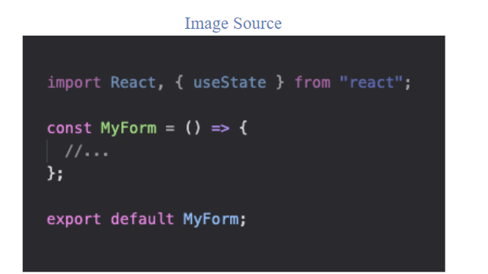
Creating a Controlled Form
To create a controlled form, define a state variable to hold input values.
Use the `value` attribute on input elements to bind them to the state variable.
Handle input changes with an `onChange` event handler to update the state.
Notes:
Image source: https://kevindiesenberg.medium.com/creating-a-controlled-form-with-react-hooks-a4b668aa8920

Slide 6
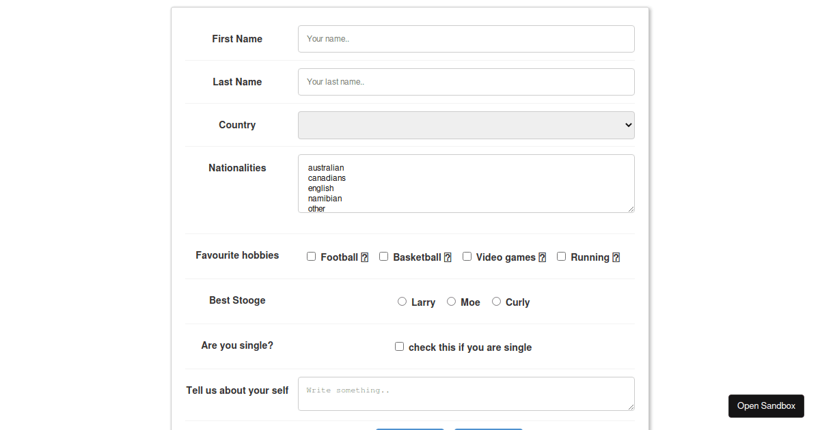
Example of a Controlled Form
Here is a simple example of a controlled form with a text input.
The form uses state to manage the input value and logs it on submission.
This structure allows for easy data manipulation and validation.
Notes:
Image source: https://codesandbox.io/examples/package/vue-controlled-form-fields

Slide 7
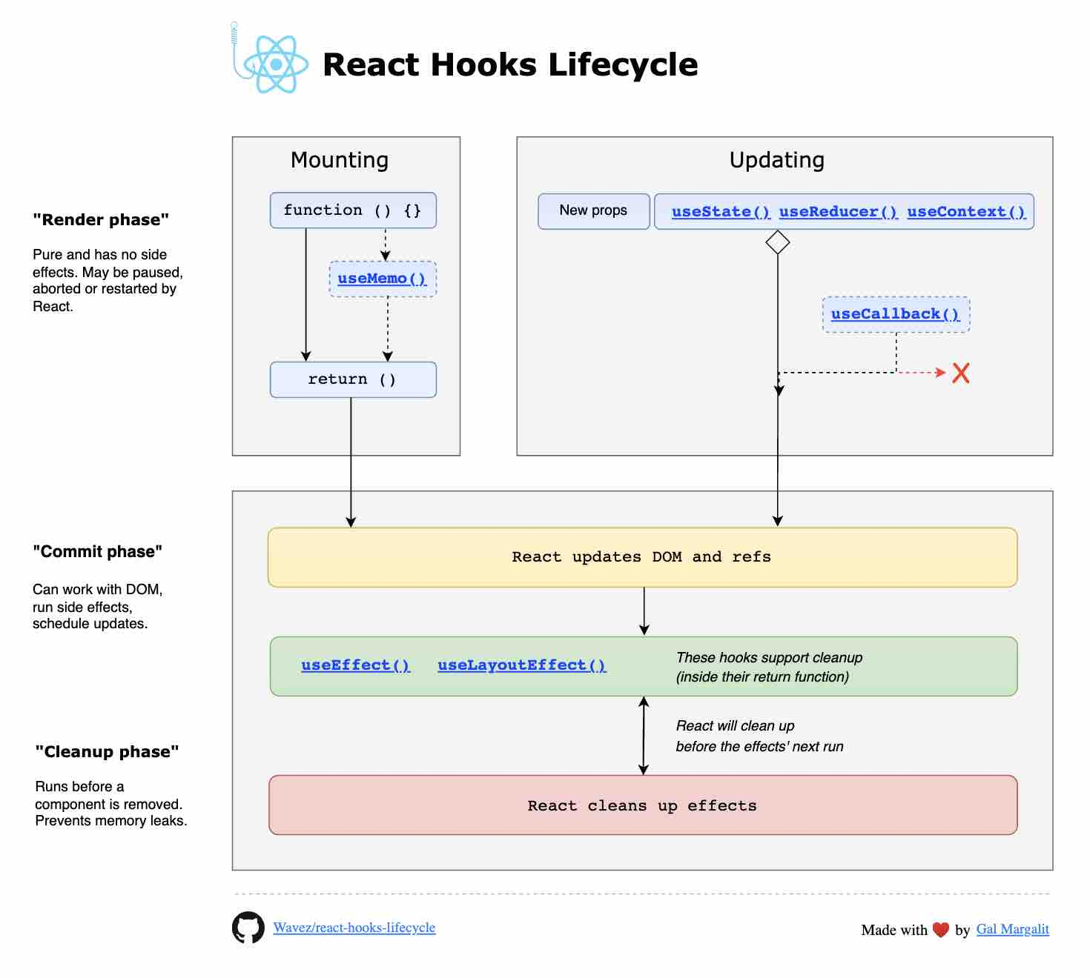
Using Hooks for Forms
React Hooks, such as `useState`, can simplify form handling in functional components.
By using `useState`, you can easily manage form data without needing class components.
This results in cleaner and more concise code.
Notes:
Image source: https://github.com/Wavez/react-hooks-lifecycle

Slide 8
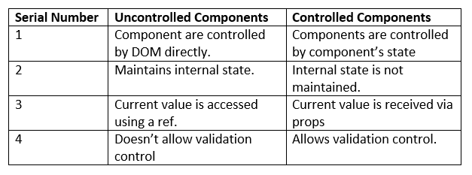
Uncontrolled Components
Uncontrolled components store their data in the DOM rather than in React state.
You can access the input values using refs, which provides a different approach to handling forms.
This method can be useful for integrating with third-party libraries or existing code.
Notes:
Image source: https://tutorialsinhand.com/tutorials/reactjs-tutorial/react-with-typescript/controlled-vs-uncontrolled-components-in-react.aspx

Slide 9
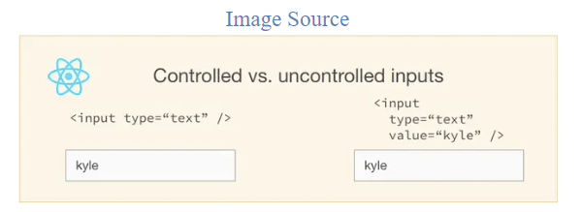
Creating an Uncontrolled Form
To create an uncontrolled form, define ref variables for input elements.
Use the `defaultValue` attribute to set initial values for your inputs.
Access form values on submission using the ref, allowing for a simpler setup.
Notes:
Image source: https://goshacmd.com/controlled-vs-uncontrolled-inputs-react/

Slide 10
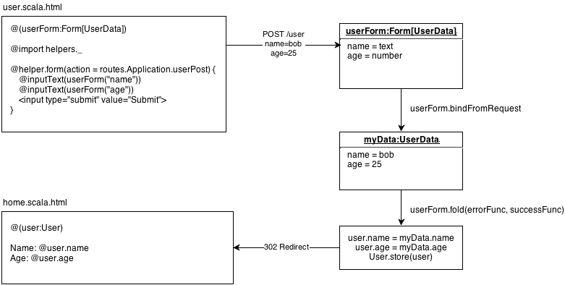
Handling Form Submission
Form submission can be handled with an `onSubmit` event handler on the form element.
Prevent the default behavior using `event.preventDefault()` to avoid page reloads.
Process the form data as needed, whether sending it to an API or performing validation.
Notes:
Image source: https://796t.com/content/1546982304.html

Slide 11

Form Validation
Validating form data is crucial to ensure data integrity and user experience.
You can implement basic validation with conditional checks in the form submission handler.
For more complex validation, consider using libraries such as Formik or Yup.
Notes:
Image source: https://www.xenonstack.com/insights/what-is-data-validation-testing

Slide 12
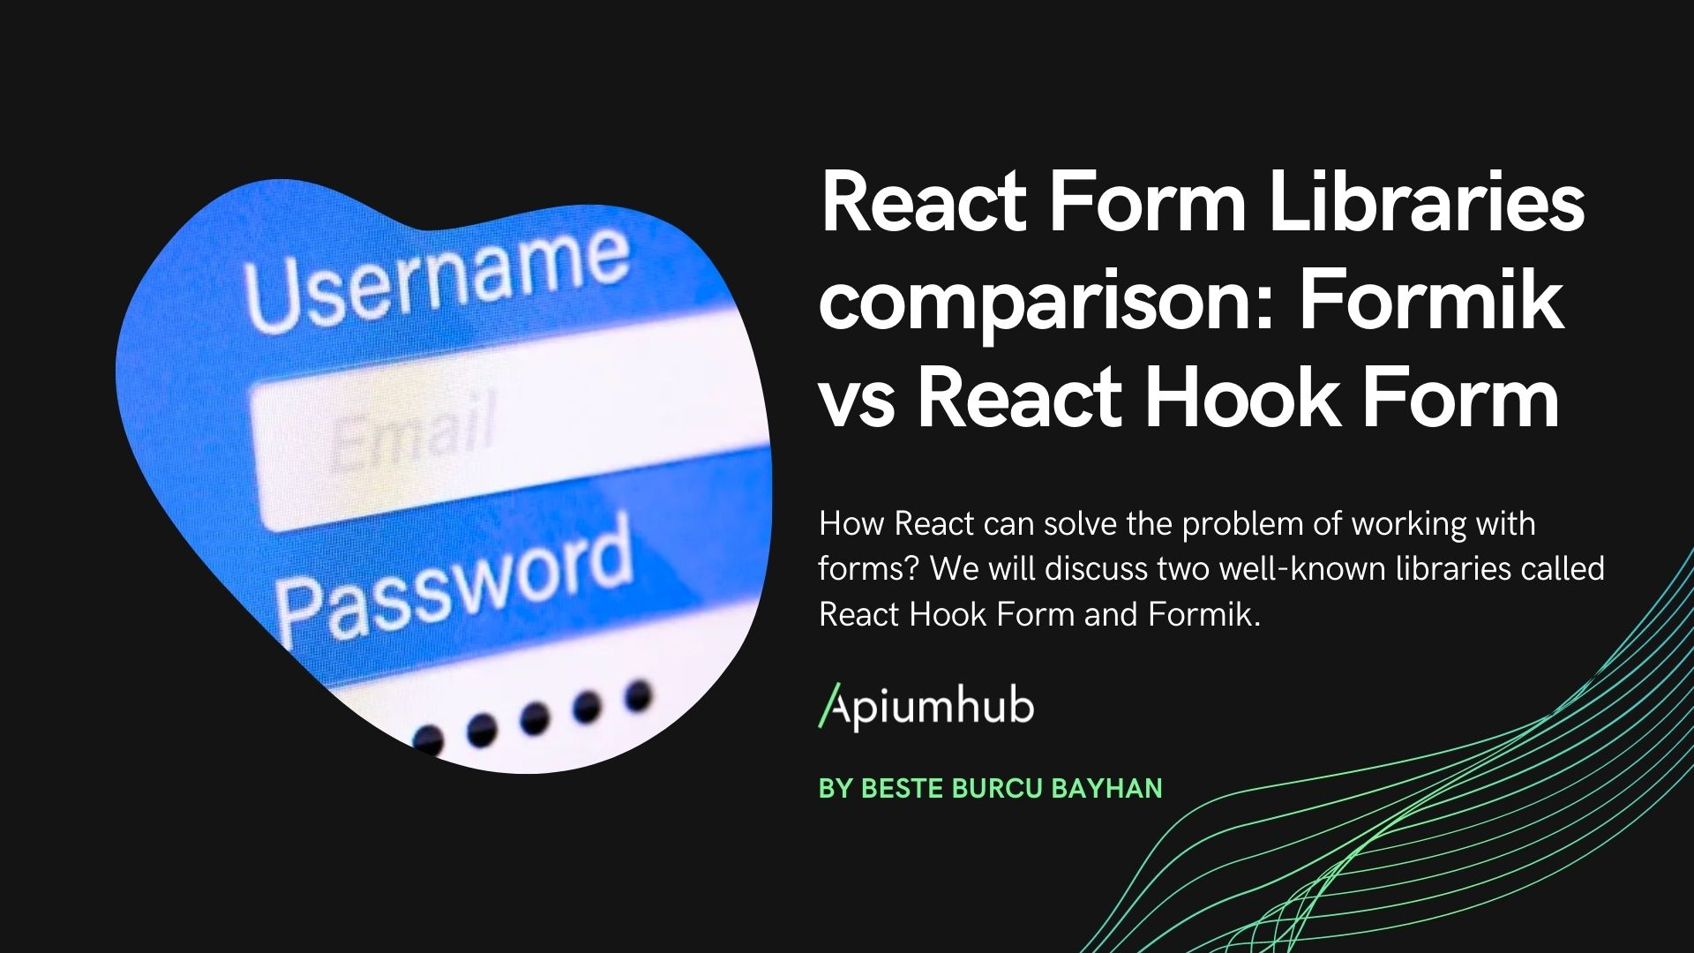
Using Form Libraries
Libraries like Formik and React Hook Form simplify form management in React.
They provide built-in validation, handling of complex forms, and better performance.
These tools can save time and improve code maintainability.
Notes:
Image source: https://myproject.co.il/react-form-libraries-comparison-formik-vs-react-hook-form/

Slide 13

Custom Form Components
Creating reusable form components can enhance code organization and reusability.
Custom components can encapsulate form logic and styling in one place.
This approach allows for consistent design and behavior across your application.
Notes:
Image source: https://morioh.com/a/8c872c74127f/ionic-tutorial-creating-reusable-custom-components-or-6

Slide 14
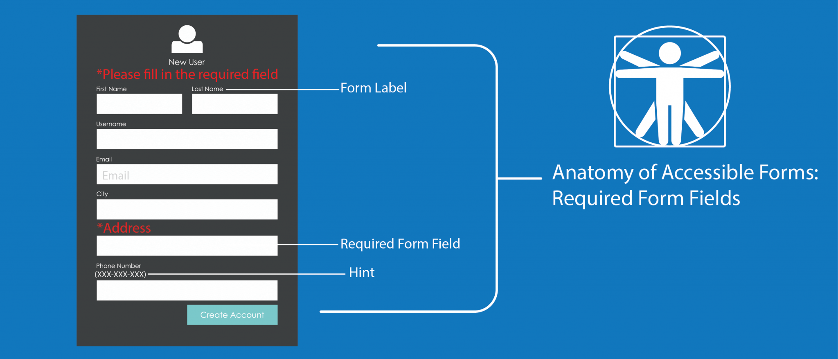
Accessibility in Forms
Accessibility is essential when designing forms to ensure all users can interact with them.
Use semantic HTML elements and ARIA attributes to improve screen reader compatibility.
Ensure that all form elements have associated labels for better user experience.
Notes:
Image source: https://www.deque.com/blog/anatomy-of-accessible-forms-required-form-fields/

Slide 15

Testing Forms in React
Testing forms is crucial to ensure functionality and reliability.
Use testing libraries like Jest and React Testing Library to create unit tests.
Focus on simulating user interactions and validating expected outcomes.
Notes:
Image source: https://www.youtube.com/watch?v=MhFSuOjU624

Slide 16

Conclusion
Mastering forms in React is vital for building user-friendly applications.
Understanding both controlled and uncontrolled components expands your toolkit.
Continuously explore libraries and techniques to enhance your form handling skills.
Notes:
Image source: https://medium.com/@hariharan.mct/mastering-dynamic-forms-with-ant-design-form-builder-in-react-b570266f8521

